Slide 1
It’s not on, if it’s not Hands-On
DevOps CICD using Jenkins, Ansible & Docker

Slide 2
Agenda
Know your Lab
Docker - Docker Image & Container
About Demo Projects
Manual Build & Deploy
Configure Jenkins
Manual Build & Deploy using Jenkins
Continuous Deployment
Continuous Integration
Build Pipeline

Slide 3









Know your lab: Lab Software

Slide 4
Know your lab: How to use your lab

Slide 5
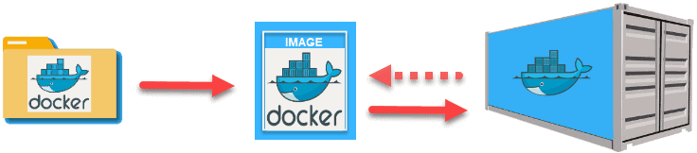
Docker - Docker Image & Container

Slide 6
About Demo Projects
Applications
https://github.com/nuvepro-hands-on-labs/DevOps-CICD-DemoProject.git
https://github.com/nuvepro-hands-on-labs/DevOpsCICD-Demo-WebApp.git
Automation
https://github.com/rishiravi17/DevOps-Test-AutomationDemo.git

Slide 7
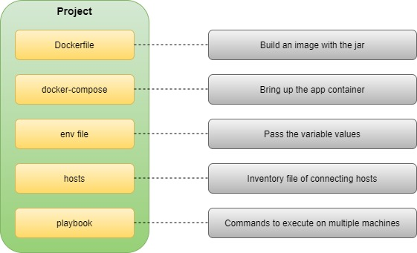
Deployment Configuration

Slide 8
Ready to go Hands-On…

Slide 9
Manual Build & Deploy

Slide 10
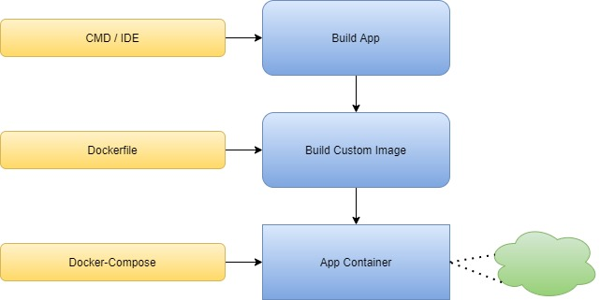
Summary: Manual Build & Deploy

Slide 11
Configure Jenkins

Slide 12
Summary: Configure Jenkins
Secret Password, Initial Plugins & Admin User
Java
Maven
Git
Publish over SSH

Slide 13
Manual Build & Deploy using Jenkins

Slide 14
Summary: Deploy using Jenkins
Added New Item
Configure SCM
Configure Build Triggers
Build Step
Post-build Action
Build & Deploy Project

Slide 15
Continuous Integration / Continuous Deployment

Slide 16
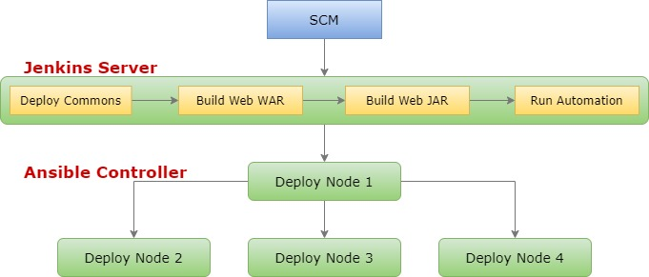


Summary: CICD

Slide 17
Build Pipeline

Slide 18
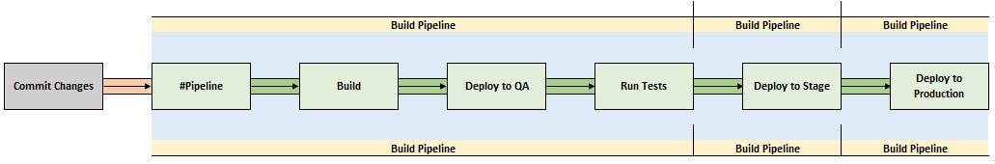
Summary: Build Pipeline

Slide 19
All set to be hands-on?

